Slide 1
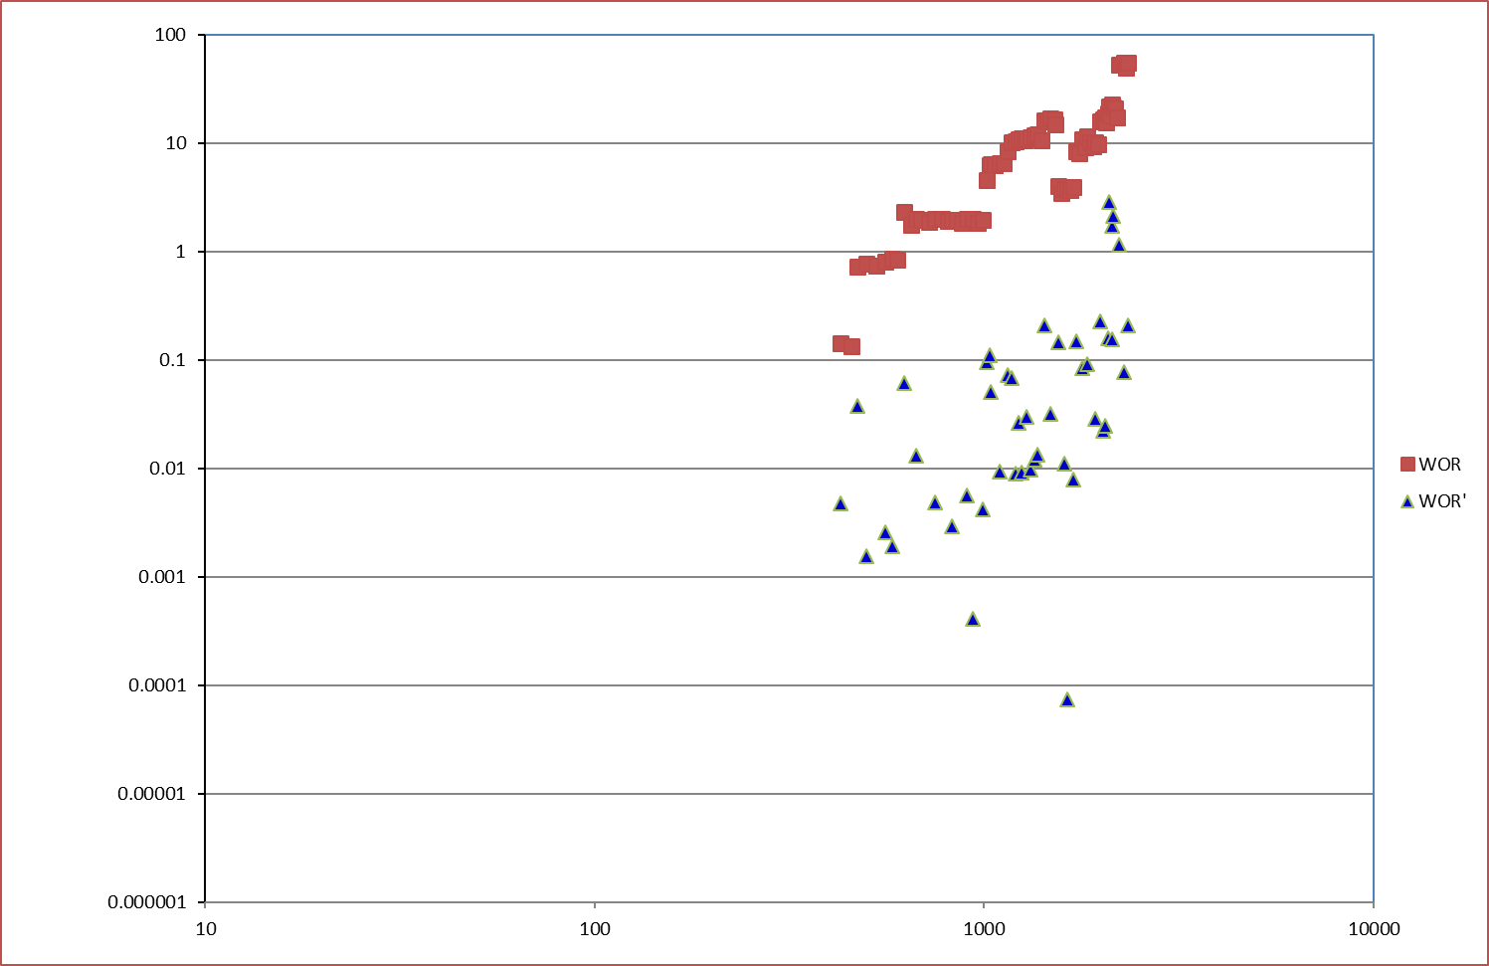
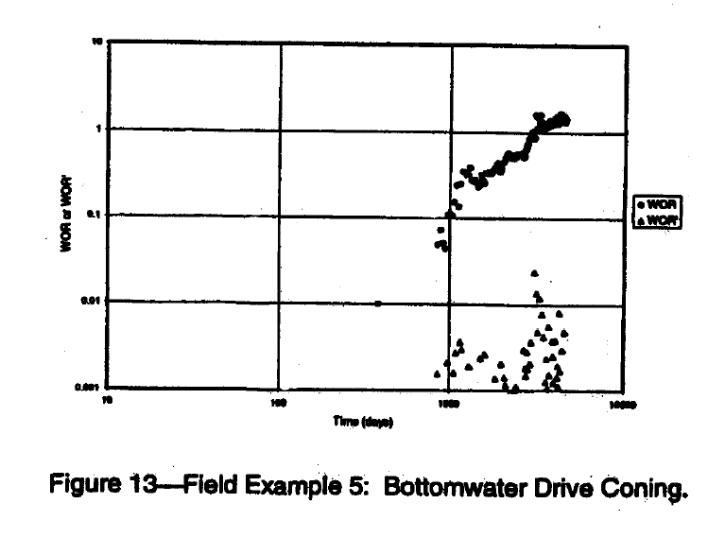
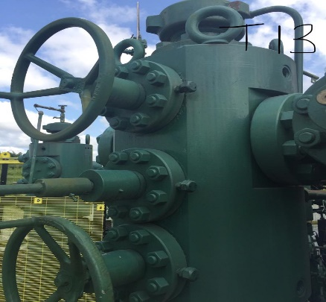
Title: Dedicated Individual Drainage Point Review of Closed in Well: TUNU010T to Add 500bopd (risked) Gains at Zero Cost
Business Case/objectives:
Increase Tunu production by 500 (risked) through identified open up opportunity
The opportunity was identified through detailed review of closed in wells in TUNU node following open up of flowstation.
The FMT performance review of TUNU10T indicated that the water produced by well is due to bottom water coning
Potential Benefits & Measurement:
500bopd (Risked)
Project Sponsor: Gogo Eneyok
Project members: Olagunju Aliyu (ADL), Etokakpan Eteobong (FMT Lead),
Osazuwa, Uyiosa,
Chukwuma Obianuju, Umeh Esther,
Esharegharan Ovokerhoyi,
Okpere Adrian, Baranu Suka
High-level Timeline:
L0-L1: June 20 2019
Critical Success Factors:
Timely response to open up notification from DPR
Optimized bean for open up
Project Scope/Actions :
Carry out integrated well and reservoir performance review
Build model to determine gain from open up
Carry out well head and flowline surveillance activities
Draft and issue open up notification letter to DPR
Share execution sequence with programmer and operations.
Source open up bean size
Implement open up opportunities and test intervals
Optimize bean size to potential
Report gains
SUBSURFACE ANALYSIS
Interval is the last well to produce from the reservoir before it was shut in for HBS&W
Water entered both wells (Tunu-001 & Tunu-010) producing from the reservoir same time due to the production from TUNU010T – see performance plots above
Well performance indicates the well has bottom water coning – see Chan plot above
Previous performance shows water receded after 3 years of shut in during Niger Delta crisis ( From 93% to 80% BSW)
Well has been shut in since 2012 (6½Years), hence coning is expected to have receded.
Prosper model indicates well can produced 500bopd (risked) at 90% BSW
SURFACE ANALYSIS
CITHP of well in January 2019 indicates an healthy CITHP of 725psig.
Flowline is available and integral
Well is integral – all well head valves passed OK.
CCU replacement is required to open well to flow and can easily be sourced

